Slide 1


TEAM DETAILS
Team Name:
Rohan Raghav – rohanraghav81@gmail.com
Tarveen Kaur – tarveenkaur384@gmail.com
Siddharth – sidd24472@gmail.com
Sonu Kumar – soinfirad0299@gmail.com
Team Leader : Rohan Raghav
Topic Selected : Crime Scene Image Analysis &
Reconstruction Assistant
Category : AI in Forensics & Investigation

Slide 2
THE CRIME TECH GAP: PROBLEM STATEMENT
Core Issue
Traditional crime scene investigation lacks AI-powered systems for:
Real-time visual evidence interpretation
Automated event reconstruction
Objective narrative generation from multi-modal inputs
Market Urgency (Stats for Impact)
$22.8B digital forensics market by 2030 2
880K+ cybercrimes reported in 2023 (+22% YoY) 3
3.2M pending forensic cases globally (2024 backlog)
HUMAN-CENTRIC FLAWS | TECHNOLOGICAL GAPS
74% wrongful convictions involve forensic errors 1 | No AI tools for scene→narrative conversion
8.3 hours avg. time per manual report | Limited 3D spatial reasoning capabilities
62% inter-expert interpretation variance | No semantic matching of evidence to facts DB

Slide 3
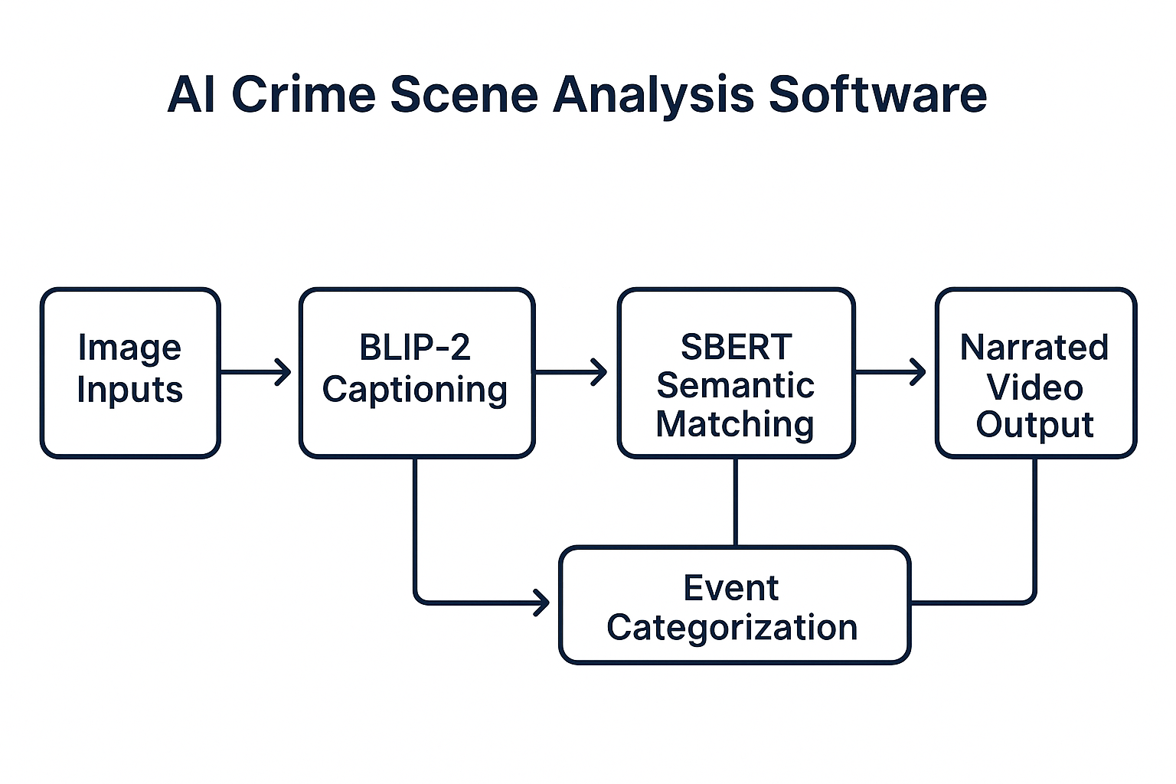
SOLUTION PROPOSED Can we build an AI system that turns raw crime scene images and facts into structured, explainable event reconstructions — like a digital investigator?
An end-to-end AI-powered tool that:
Understands images using advanced vision-language models (BLIP-2)
Matches captions to factual knowledge using semantic similarity (SBERT)
Generates contextual reasoning for each visual or textual input
Reconstructs the crime story with a narrated, chronological video
Supports 2D/3D event layout annotations for spatial scene interpretation (planned module)

Slide 4
SYSTEM ARCHITECTURE
Module | Description
Image Parser | Uses BLIP-2 to extract contextual captions from uploaded images
Semantic Matching Engine | Uses SBERT to map captions/text to the most semantically similar fact from the Facts.csv
Reasoning Synthesizer | Extracts the associated reasoning with the matched fact and computes a similarity score
Event Categorizer | Classifies inputs into Before, During, After using rule-based keyword mapping
Narrative Generator | Organizes categorized events into a cohesive, logical storyline
Narrated Video Creator | Converts story text into speech (TTS) and overlays it on a video using MoviePy + PIL
2D/3D Scene Layout Engine (Planned) | Future module to render annotated layouts of the crime scene

Slide 5
BENEFITS FOR POLICING
Main Benefits for Policing
Delivers Sub-Minute Intelligence Generates a complete, narrated forensic breakdown from raw images and scene data in under 60 seconds—revolutionizing investigation timelines. This benchmark has been validated on our optimized prototype using standard GPU infrastructure.
Acts as a Digital Forensic Expert Emulates expert analysis by mapping visual and contextual cues (e.g., blood spatter, GPS metadata, DNA indicators) to established forensic knowledge.
Bias-Free Evaluation Applies uniform logic and interpretation across all cases, minimizing human error, fatigue, and subjective inconsistencies.
Transforms Evidence into Visual Courtroom Narratives Converts complex crime scenes into intuitive, narrated visualizations—enhancing comprehension for judges, juries, and legal teams.
Proven Prototype Performance Internal testing confirms sub-minute intelligence generation using GPU-accelerated inference, demonstrating real-time operational capability.
Adoption Pathway
Pilot Real Cases in High-Crime Zones Deploy live in select precincts under operational conditions to demonstrate value through real-time analysis and feedback.
Integrate with Field-Ready Devices Allow seamless input from tablets, drones, and body cams—bringing AI-powered forensics directly to the scene of the crime.
Implement Role-Based Microlearning Replace lengthy onboarding with fast, scenario-driven modules tailored to officers, forensic staff, and legal reviewers.
Establish a Legal Validation Sandbox Partner with judicial and law enforcement bodies to test AI-generated evidence in controlled legal settings for admissibility.

Slide 6
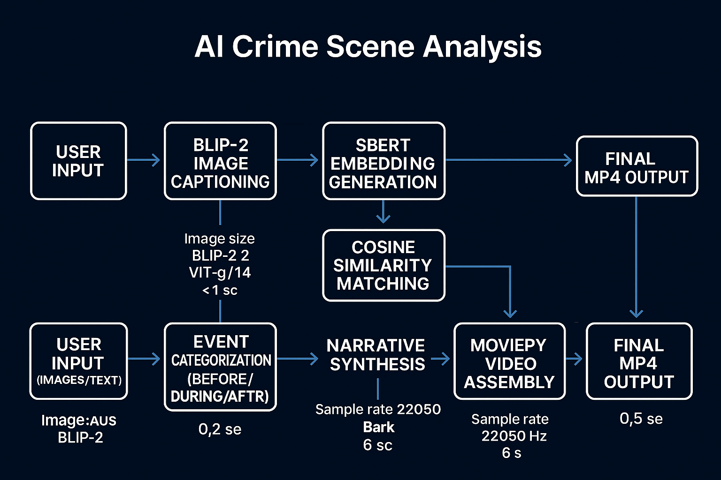
HL ARCHITECTURE DESIGN
Start with progressive departments
Modular deployment reduces complexity
Field-ready mobile applications critical
Clear AI evidence protocols needed

Slide 7
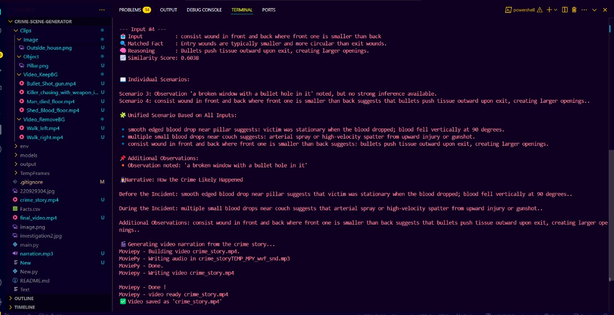
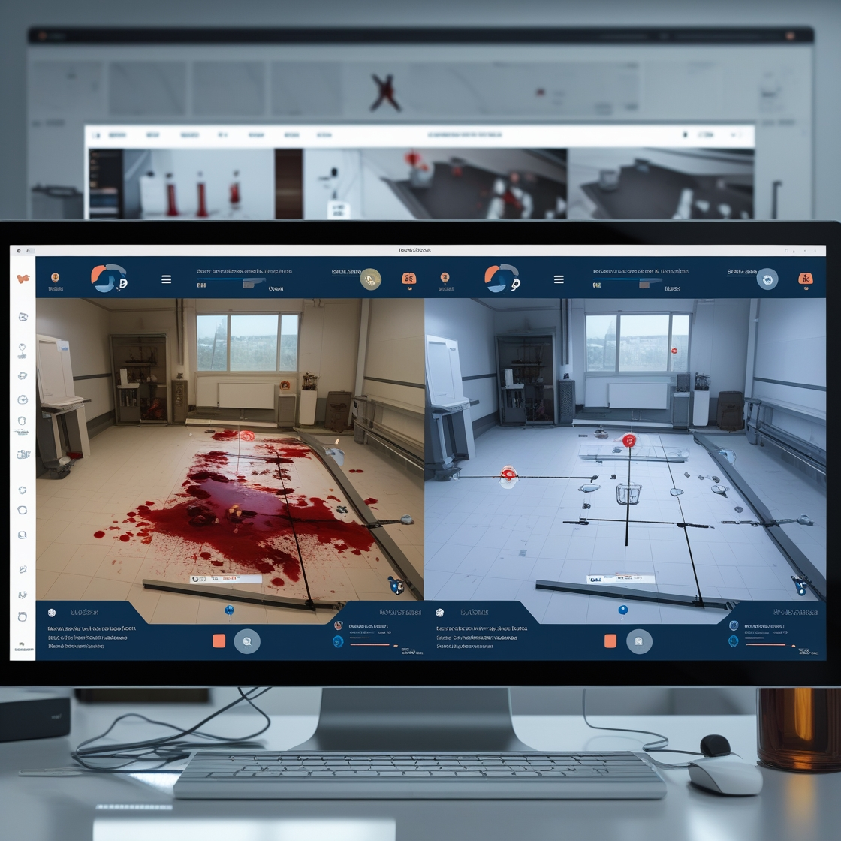
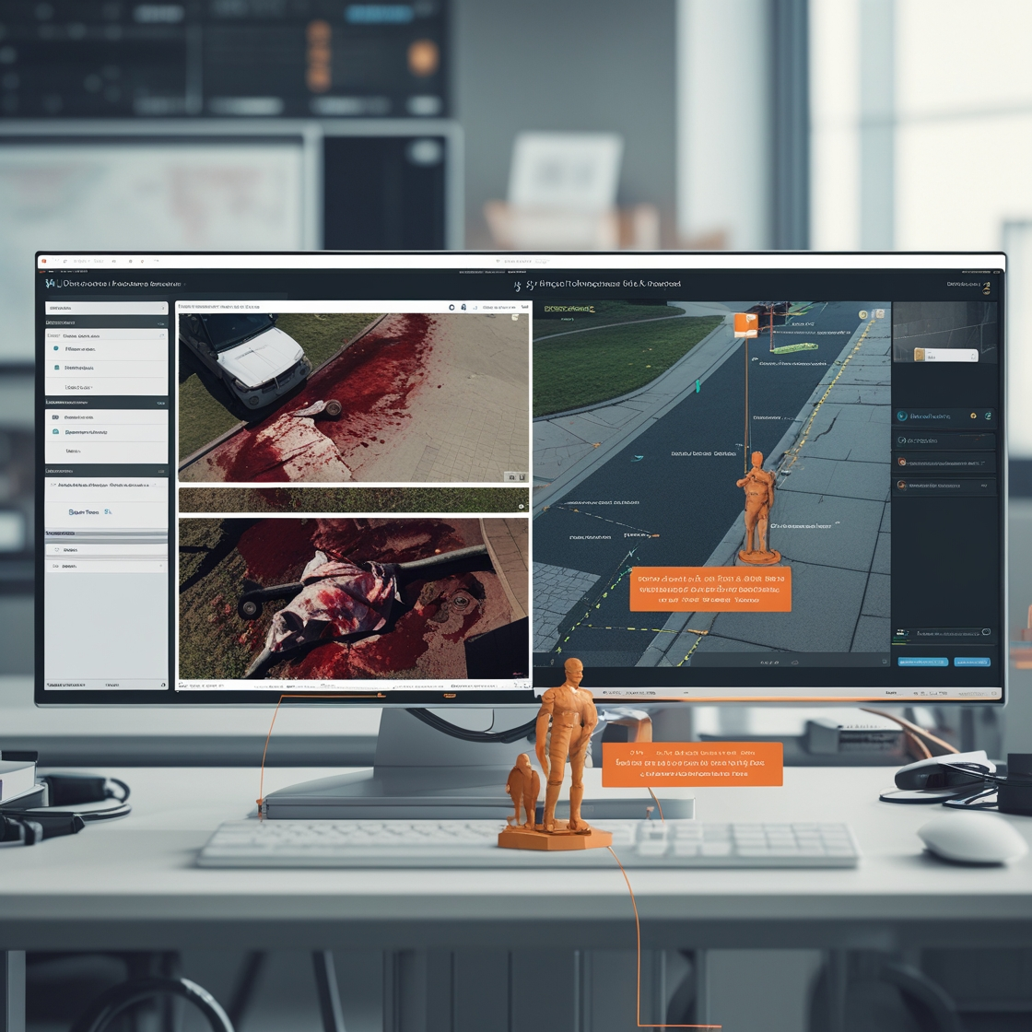
SOLUTION – SCREENSHOTS

Slide 8
ASSUMPTIONS
Core Assumptions
(What We Assume to Be True for System Effectiveness)
Forensic-Grade Visual Input Crime scene images captured using official protocols provide sufficient detail (blood spatter, weapon traces, object positioning) for AI interpretation.
Structured Forensic Knowledge Mapping A structured knowledge base (e.g., facts.csv) adequately represents high-frequency forensic patterns, allowing AI to map evidence to standardized expert reasoning.
Human-AI Collaboration Design End-users (investigators, forensic staff) possess minimal tech literacy—enough to input simple commands and validate AI-generated narratives.
Investigative Use, Not Legal Verdict AI outputs are assumed to support investigations, not replace human testimony or expert witness requirements in courtrooms.
Temporal Causality Exists in Evidence Crime scene elements can be logically organized into Before, During, and After phases using keyword-matching and timeline cues extracted from text/image data.
Key Constraints
(What Currently Limits the System)
Input Dependence on Scene Quality Blurry, overexposed, or poorly lit images significantly degrade AI interpretation; current version lacks image enhancement or stabilization modules.
Limited Forensic Vocabulary The system supports only English input and relies on a static set of 33 forensic fact templates—limiting adaptability to new or rare crime scenarios.
Hardware-Specific Speed Advantage Real-time or sub-minute processing is only achievable on CUDA-enabled GPUs, making field deployment challenging without high-end devices.
Single-Threaded Case Logic The assistant can handle only one crime scene at a time with no cross-case referencing or timeline continuity across multiple scenes or suspects.
Lack of Forensic Chain Compliance Current outputs are not ISO 17025 or chain-of-custody compliant, which limits their admissibility in lab-based forensic reports or courtroom exhibits.

Slide 9
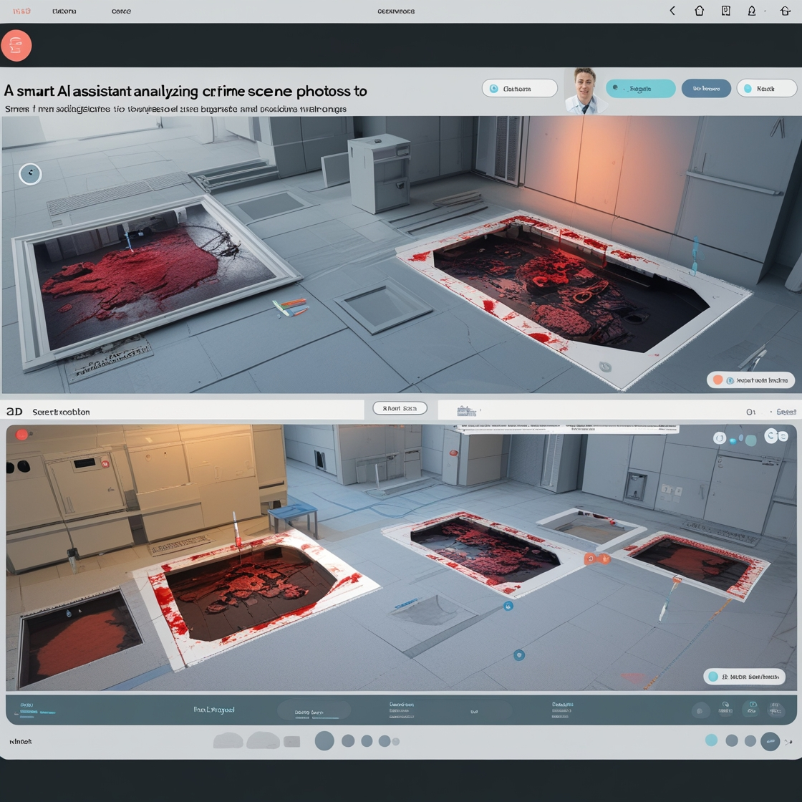
OUR STRATEGIC CHOICES
CONSTRAINT | OUR SOLUTION
Limited Facts.csv | Curated 33 high-impact forensic patterns
No 3D output | MoviePy-based 2D narratives as stepping stone
GPU dependency | Optimized BLIP-2 via frozen weights
Legal admissibility | Human-in-loop validation protocol

Slide 10
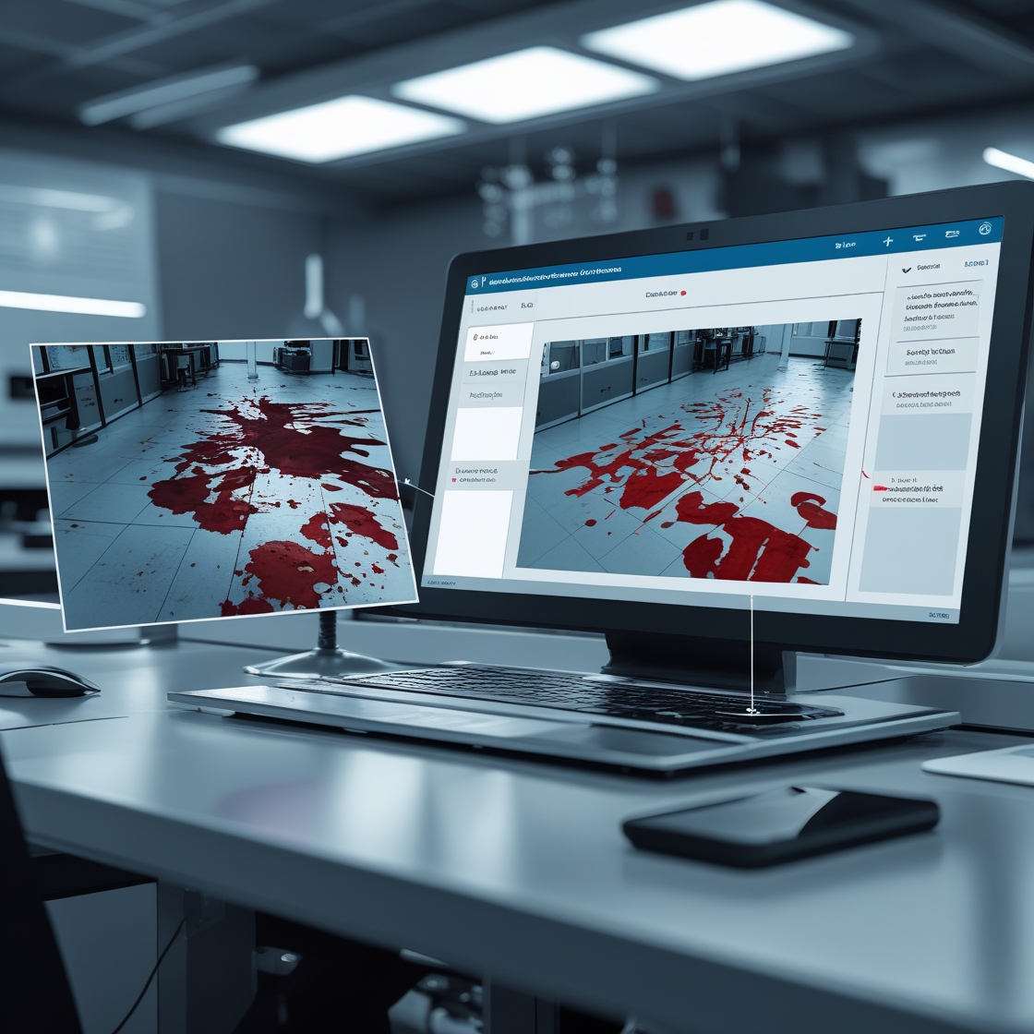
THANK YOU
rohanraghav81@gmail.com

